Slide 1


B.Tech Computer Science and Engineering – Vth Semester
Theory of Computation
Department of Computer Science and Engineering

Slide 2
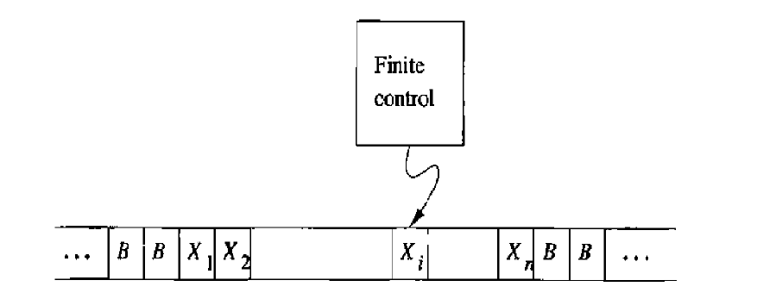
Turing Machine (TM)
A Finite control which contains one more number of states.
A tape where we place the input to be parsed.
The tape will extend infinitely on left and right sides.
The tape can have symbols other than input symbols which includes ‘B’ which is a blank.
There is a tape head which can read symbols from the tape.
The tape head will be initially placed on the left most symbol of the input.

Slide 3
A move in the Turing Machine (TM)means
It is a function of state of the finite control and the tape symbol scanned.
In one move the Turing Machine will
Change state. The next state optionally can be the same state also.
Write a tape symbol in the cell scanned, the symbol will replace whatever symbol was in that cell. The symbol written may be the same symbol currently there(No change).
Move the tape head left or right

Slide 4
Notation for the Turing Machine (TM)
Any TM ‘M’will be decided by 7 tuple.
M=(Q,∑,Γ,δ,q0,B,F)
Q-> Finite set of states.
∑->Set of input symbols.
Γ->Set of tape symbols. ∑ is always a subset of Γ.
B-> the blank symbol , all empty cells in the tape will have this.
F->Final or accepting states which is a subset of Q.

Slide 5
Notation for the Turing Machine (TM)
δ-> δ(q,X)=(p,Y,D) are a state q and a tape symbol X.
p is the next state in Q.
Y is the symbol in Γ which will replace the older symbol in tape.
D->Direction of head movement. L for Left and R for Right.

Slide 6
Instantaneous Description of TM
X₁ X_{2 …}X_{i-1} q X_{i} X_{i+1} …X_{n}
q-> current state of the TM.
The tape symbol is scanning the i^{th} from the left
X₁ X_{2 …}.X_{n} is the portion of the tape between the left most and right most non blank.
If the tape head is to the left of the left most nonblank or to the right of the right most non blank then then some prefix or suffix of X₁ X_{2 …}.X_{n} will be blank and ‘i’ will be 1 or n.

Slide 7
Suppose δ(q,X_{i})=(p,Y,L) then the move will be
X₁ X_{2 …}X_{i-1} q X_{i} X_{i+1} …X_{n} Ⱶ X₁ X_{2 …} X_{i-2} p X_{i-1} Y X_{i+1} …X_{n}
There are two important exceptions to this general assumption.
If i=1 then M moves to the blank on the left
qX₁ X₂ …_{Xn} Ⱶ p B Y X₂ …Xn
If i=n and Y=B then B need to be written over X_{n}
X₁ X₂ …qX_{n} Ⱶ X₁X₂ … X_{n-2}pX_{n-1}

Slide 8
Now suppose δ(q,X_{i})=(p,Y,R) then the move will be
X₁ X_{2 …}X_{i-1} q X_{i} X_{i+1} …X_{n} Ⱶ X₁ X_{2 …} X_{i-1}Y p X_{i+1} …X_{n}
In this case we have two exceptions
If i=n, then the i+1st cell is blank and is also included in ID
X₁ X_{2 …}X_{n-1}qX_{n} Ⱶ X₁ X₂ …X_{n-1}YpB
If i=1 and Y=B, then the symbol is written over X₁ joins the infinite sequence of leading blanks and does not appear in the next ID.
qX₁ X_{2 …}X_{n} Ⱶ p X₂ …X_{n}

Slide 9
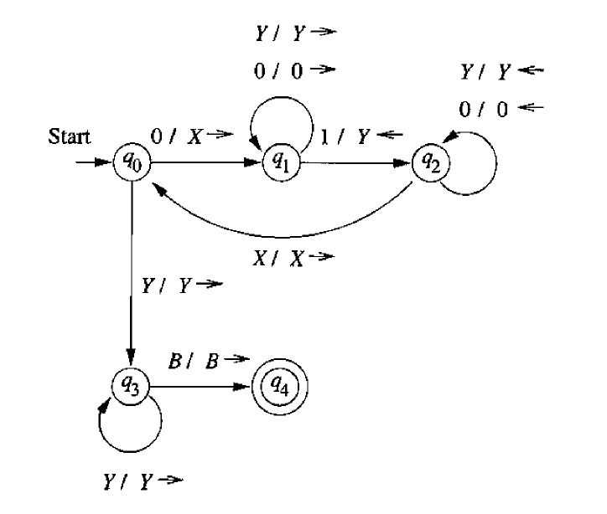
Thank You .. Have a Great Day

Slide 10
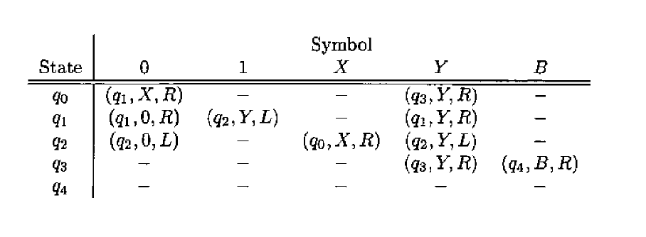
The Transition Table
 | 0 | 1 | X | Y | B
q0 | (q1,X,R) | ~ | ~ | (q3,Y,R) | ~
q1 | (q1,0,R) | (q2,Y,L) | ~ | (q1,Y,R) | ~
q2 | (q2,0,L) | ~ | (q0,X,R) | (q2,Y,L) | ~
q3 | ~ | ~ | ~ | (q3,Y,R) | (q4,B,R)
q4 | ~ | ~ | ~ | ~ | ~

Slide 11
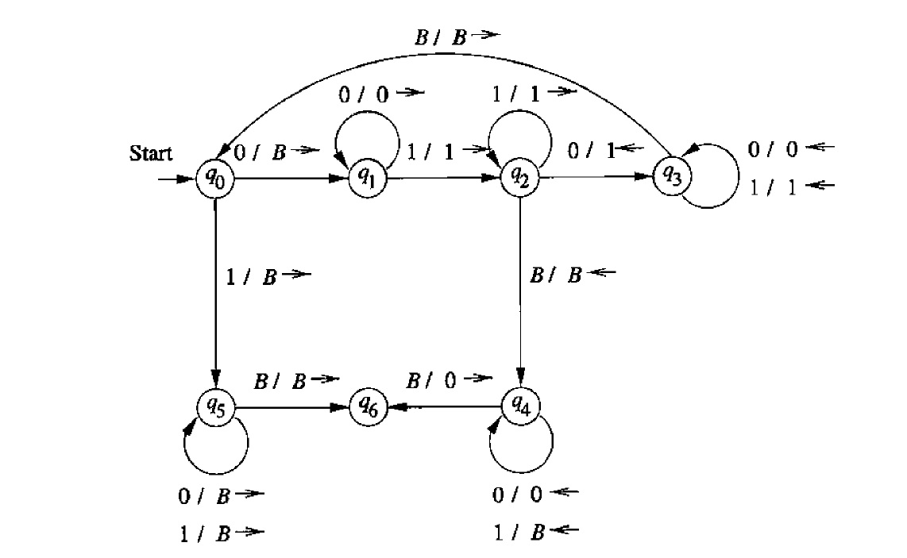
TM for Proper Subtraction (demo in JFLAP)

Slide 12
Transitions of the Proper Subtraction TM for Input 000100 - (3-2=1)
q₀000100 Ⱶ Bq₁00100 Ⱶ B0q₁0100 Ⱶ B00 q₁100
Ⱶ B001q₂00 Ⱶ B00 q₃110 Ⱶ B0 q₃0110 Ⱶ B q₃0 0110
Ⱶ Bq₃00110 Ⱶ q3B00110 Ⱶ Bq₀00110 Ⱶ BBq₁0110
Ⱶ BB0 q₁110 Ⱶ BB01q₂10 Ⱶ BB011 q₂0
ⱵBB01q₃11 Ⱶ BB0 q₃111 Ⱶ BB q₃0111
Ⱶ B q₃B0111 Ⱶ BB q₀0111 Ⱶ BBBq₁111
Ⱶ BBB1q₂11 Ⱶ BBB11 q₂1 BBB111 q₂B
Ⱶ BBB11 q₄1B Ⱶ BBB1 q₄1 BB Ⱶ BBB q₄1 BBB
ⱵBBBBBq₄BBBB Ⱶ 0q₆B

Slide 13
Points to Ponder
Here q₆ is not final ; but it has not no transition out of it. So this TM accepts string by a concept called as ‘halting’.
The TMs will also accept by final state. (final state eventually will be a halting state).
All the languages which are accepted by TM s are called as Recursively Enumerable Languages.

